Slide 2
Franchise Renewal 101
Gerard Lavery Lederer
Partner

Slide 3
Overview
Attorney-Client Privileged Communication
The Basic Laws
Translating the Laws Into A Local Process –
Key Questions

Slide 4
The Basic Laws
47 U.S.C. Sec. 521 et seq. (the “Cable Act”), esp. Sec. 546
State law
YOUR Charter, Franchise, Ordinances

Slide 5
Cable Act
Defines what you can and cannot require, and can and cannot enforce
Internet?
Specific video programs?
Defines the permitted franchise fee – and what counts against the fee?
Renewal consultant fees?
Capital support?
Operating support?
School and Government Building Drops

Slide 6
Cable Act
Prescribes renewal process (Sec. 546)
Two processes – “informal” and “formal”
Informal process =
Agree at any time;
Must hold hearing where public can comment
Otherwise, the process is done

Slide 7
Cable Act – Formal Process
How it starts: You can start it; or operator can start it by submitting a request for renewal 30-36 months before franchise is scheduled to expire
What happens when it starts: you then have six months to commence a proceeding in which the public has an opportunity to participate….

Slide 8
Cable Act – Formal Process
What’s the proceeding?
You are to determine the future, cable-related needs and interests of the community AND
Review the operator’s past performance
How formal do I have to be in starting the process
Not very – BUT….
When do I need to end it?
No deadline for ending

Slide 9
The Cable Act – Formal Process
How do formal and informal fit together?
You can assess community needs/past performance until you have a negotiating position with which you are comfortable.
You can then negotiate informally.
If negotiations fail, you can then complete the “assessment” process, and move forward formally.

Slide 10
The Cable Act – Formal Process
What Happens When the Assessment is Completed?
Community can issue a request for proposals OR operator can submit a formal proposal without waiting for an RFP.
Once operator proposal is received, community has four months to decide to say “yes” or to say “we preliminarily deny the renewal request”
If you say no, operator may require community to promptly commence an administrative proceeds (almost like a trial)

Slide 11
The Cable Act – Formal Process
What Goes On at the Administrative Proceeding? You consider:
Whether the operator has complied with its obligations under the franchise and applicable law (notice/cure)
Whether the operator has provided adequate service in the past (notice/cure)
Whether the operator has the financial, technical and legal ability to perform as promised
Whether the operator’s proposal is reasonable to meet the future, cable-related needs and interests of the community in light of the costs thereof

Slide 12
The Cable Act – Formal Process
Denial permitted if you find against the operator on any one of those four grounds
Operator can appeal to court

Slide 13
Key Questions
When Do You Need To Start? When Do You Need to Finish?
If you fail to complete before franchise ends, operator theoretically could ask court to direct you to move forward with the process or grant other relief
In practice, an operator will typically take the position that until the formal process is completed, it may continue to operate under the terms of the existing franchise
That may be good in some communities, costly in others

Slide 14
Key Questions
How Does the Law Fit Into a Sensible Process?
You need to coordinate the formal and informal processes, but set deadlines so you can complete renewal in a time frame that makes sense for your community
Rational process for gathering information required to negotiate
Set deadlines for negotiations
Keep elected officials informed and engaged

Slide 15
Key Questions
Can I Still Get Benefits for My Community?
PEG Channels and Support?
Institutional Network?
Rebuilds?
Answer – YES!
But, you must be prepared to fight for those benefits

Slide 16
What New Challenges Will Arise?
PEG
How do you defined channel in a digital world?
HD? What about future advancements?
Who can view the channels? [the basic service problem]
Operating support?
VoD?

Slide 17
What New Challenges Will Arise?
I-NET – build v. “buy” equation is very different
Most favored nations clauses – new risks
OTT television
How do I deal with the possibility of competitive entry?
Scope of the franchise – cable communications? Or just cable

Slide 18
Should I Be Working With Other Communities?
…it depends
Exchange of information is important
Working together at state/FCC is important
…and if a fight develops, you may all have an interest in working together

Slide 19
Gross Revenue
Does not address the allocation of bundled packages which are the new hot topic.

Slide 20
Overview
Common Franchise Renewal Issues
Franchise Fees
Cable System Issues
Customer Service
Institutional Networks
Competition and Level Playing Field
Others
PEG-Related Issues

Slide 21
Renewal Issues: Non-PEG-related

Slide 22
Franchise Fees
Franchise fees cannot exceed 5% of operator’s “Gross Revenues” (47 U.S.C. § 542)
How do you define “Gross Revenues”?
Triple play
Over the top services
Advertising
Programming launch fees
Application of GAAP

Slide 23
System Issues
System Build-out
Density requirements
Commercial areas
System Upgrades:
an LFA may not use its franchising authority to attempt to regulate non-cable services
But many of the services using system capacity are not “cable”

Slide 24
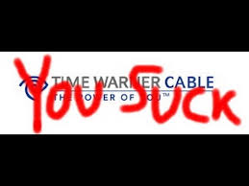
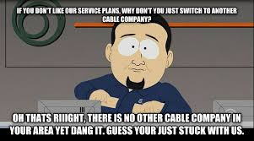
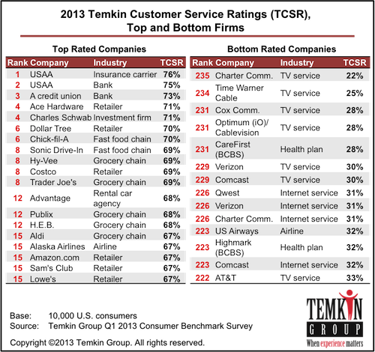
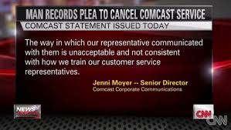
Customer Service

Slide 25
Institutional Networks
Connect public buildings. Transport PEG programming
Who owns what?
Dark fiber vs. managed services
New entrants vs. incumbents

Slide 26
Competition and Level Playing Field
Federal law does not require such provisions
Examples of Provisions Requested by Operators in Renewal Process
Defining competitor as broader than other cable operators (OTT)
Opt-out provisions to avoid franchise obligations
Allowing operator to unilaterally modify franchise if different than competing franchise

Slide 27
Others
Term / rights on termination
Precedence of franchise vs. ordinance
Reporting requirements
Liquidated damages
Security for performance
Audit rights

Slide 28
Renewal Issues: PEG-related

Slide 29
PEG Support
The term “Franchise Fee" does not include:
Capital costs which are required by the franchise to be incurred by the cable operator for public, educational, or governmental access facilities. (47 U.S.C. § 542)
Ways to Impose PEG fee
Upfront, pay as you go, periodic payments
Payments tied to subscriber numbers
% of “Gross Revenues”
In-kind
Operating support

Slide 30
PEG Channels
How do you define channel in a digital world?
How many?
What format? HD? Simulcast? What about future advancements?
Channel placement
Information about channels on EPGs

Slide 31
Summary
Renewals only happen every 10-15 years
Franchise renewals deal with a diverse range of issues negotiated over months or years
Both sides bring issues to the table
Relative importance of PEG-related issues:
What other issues are under negotiation?
What have other renewals done lately?
How strong is community support for your issues and how do you demonstrate that?
Working with the negotiating team
Timing

Slide 32
Cable Television
State law generally defines authority to issue cable television franchises
Traditionally, cities and counties issued cable franchises
California adopted state franchise model in 2006
47 USC § 521 et seq. establishes certain parameters
Ban on exclusive franchises
Franchise fee capped at 5 % of gross revenues
Public, Educational and Government (PEG) fees used for capital expenditures
Rate regulation/charge regulation
Franchise renewal rights
Transfers shot clock
Cable-related – cannot use cable authority to regulate telephone/Internet service

