Slide 1
Evolving
“By Any Media Necessary”
How we stopped worrying and learned to love
high speed internet at BCTV

Slide 2
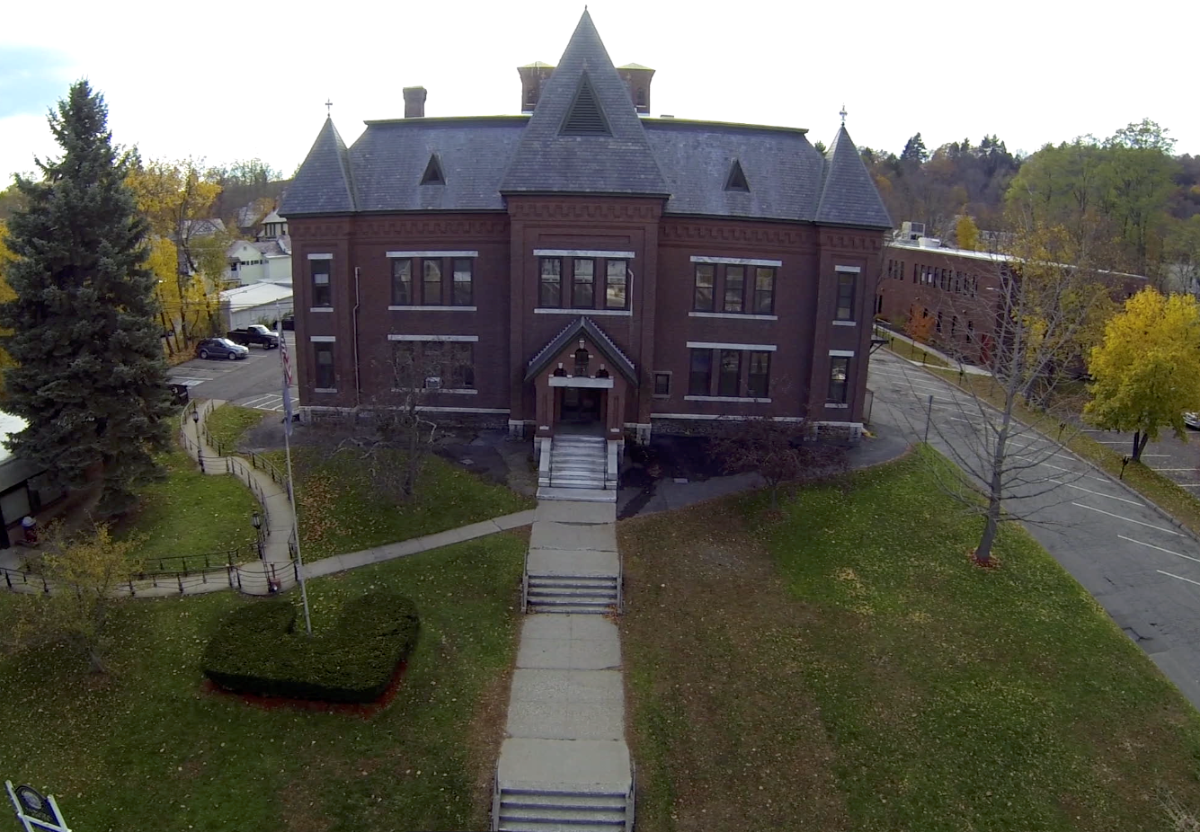
Who are we?
BCTV’s office and Studio in the Brattleboro Municipal Center

Slide 3
Who are we?
Brattleboro Community TV (BCTV)
Small public access center in Vermont serving a rural area around a large town/small city of 12,000
Wide range of internet speeds
Low cable penetration outside main roads in outlying towns

Slide 4
Why are we part of this panel?
One year ago: wired to fiber network
Here to share what changed at the station internally and externally
Practical perspective

Slide 5
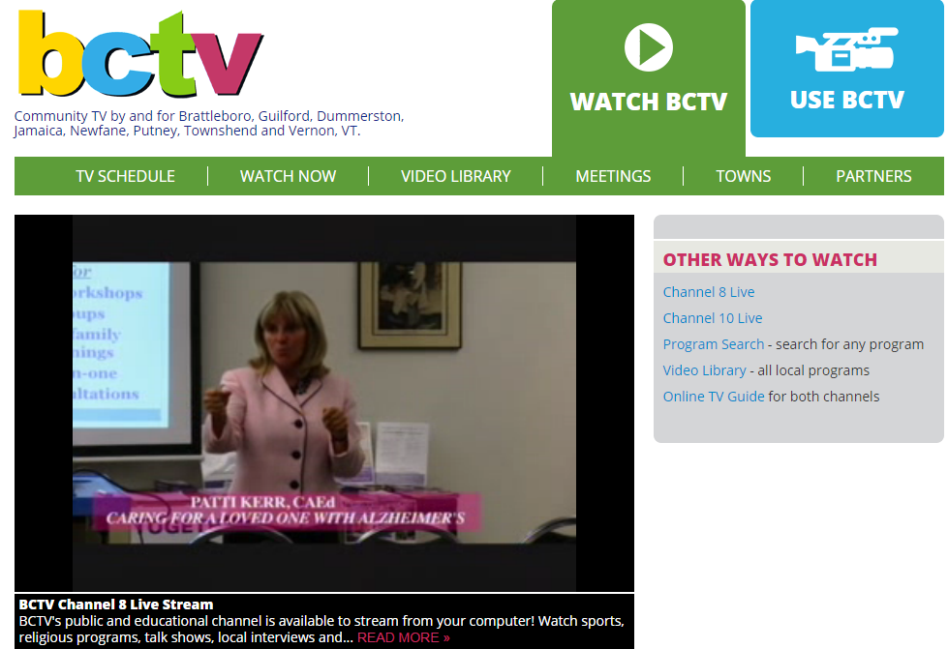
Live stream of two channels

Slide 6
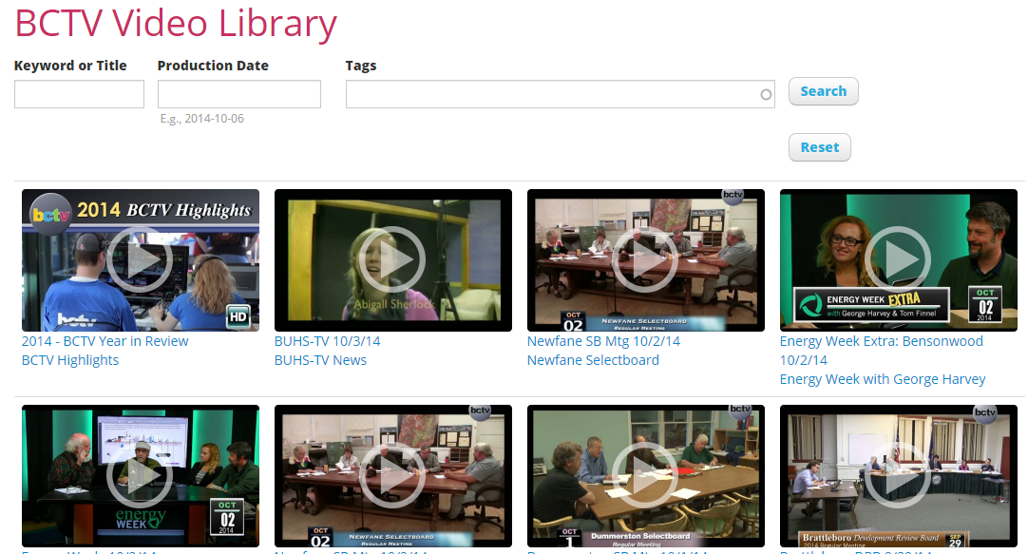
On-demand Video Library with adaptive bitrate

Slide 7
What do we mean by High-Speed?
Previous package:
Comcast Business Service:
  5 UP
  20+ DOWN
  Shared bandwidth (dependent on time of day and neighboring uses)
  Quota cap for streaming
  Uploads affected downloads

Slide 8
What do we mean by High-Speed?
Current package:
Sovernet Fiber Service:
  30 mbps UP
  30 mbps DOWN
  Dedicated bandwidth
  Potential for point-to-point connection with other anchor institutions
  Quality of connection> Quantity

Slide 9
Internal changes:
Uploading to VOD (TelVue, YouTube)
Downloading from Vermont Media Exchange etc
  Happens all day long, takes minutes
  Multiple programs at a time
  One hour program used to take 6 hours+
  Used to do overnight, lots of incomplete up/downloads and lost time
Able to move all internet uses to one account, one modem

Slide 10
Internal uses:
Trend toward cloud-based subscription services for video production:
  Filesharing (Mediafire, Hightail)
  Editing (Adobe Creative Cloud)
  Archiving & File Backup (BackBlaze)
All rely on speed and no “blips” in service

Slide 11
External Uses
Internal uses are invisible to the outside world
External uses - new ways of producing and presenting programs
Take it away, Roland!

Slide 12
Expands live programming opportunities
Live stream over YouTube from anywhere with adequate upload speeds
Combined with Google Apps for Nonprofits
Recent example: Temple Grandin lecture at Landmark College
Link created two weeks earlier and publicized [video]

Slide 13
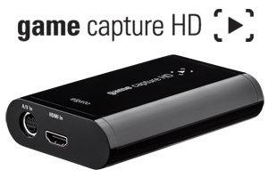
Consumer-level equipment in the field:
Elgato Game Capture HD Game Recorder
Mac/PC laptop with GameCapture software
HDMI cable
HD camcorder

Slide 14
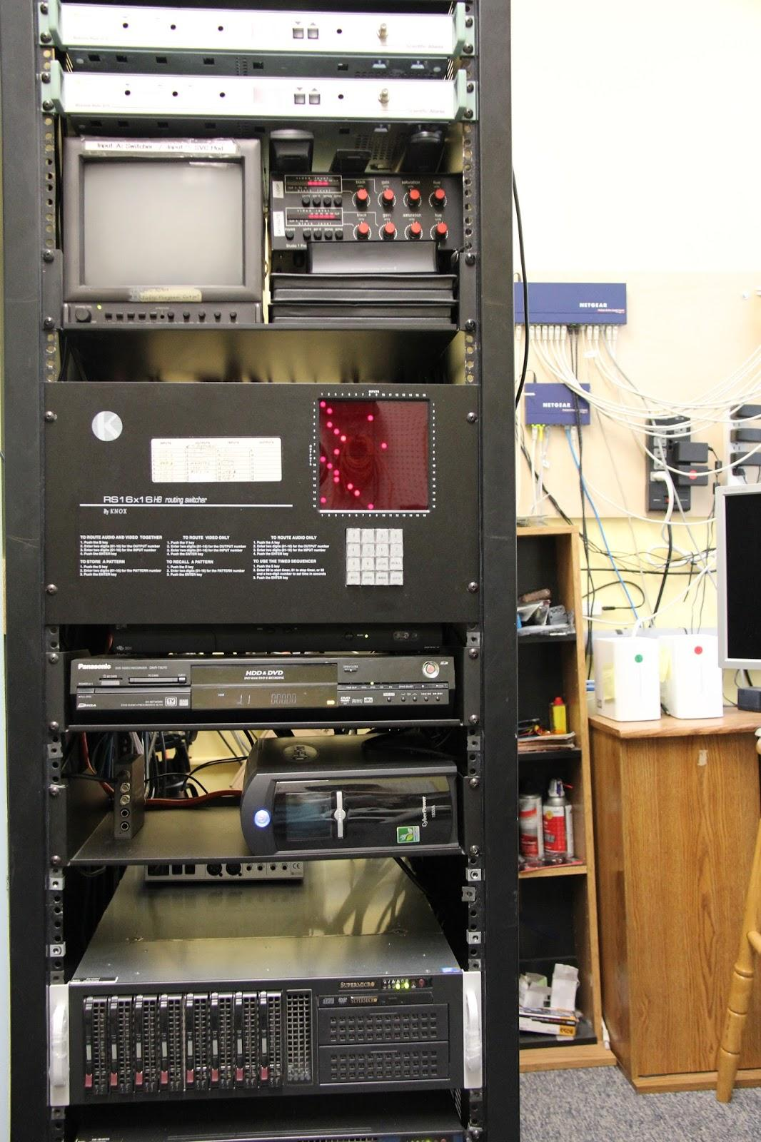
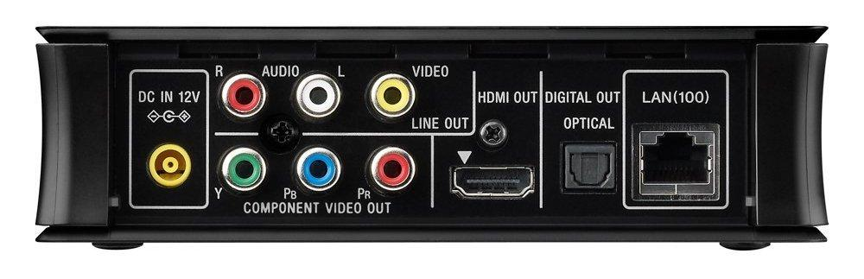
Consumer gear in the rack:
Sony SMP-N200 Streaming Media Player
Control with smartphone app
Serves as SD down-converter

Slide 15
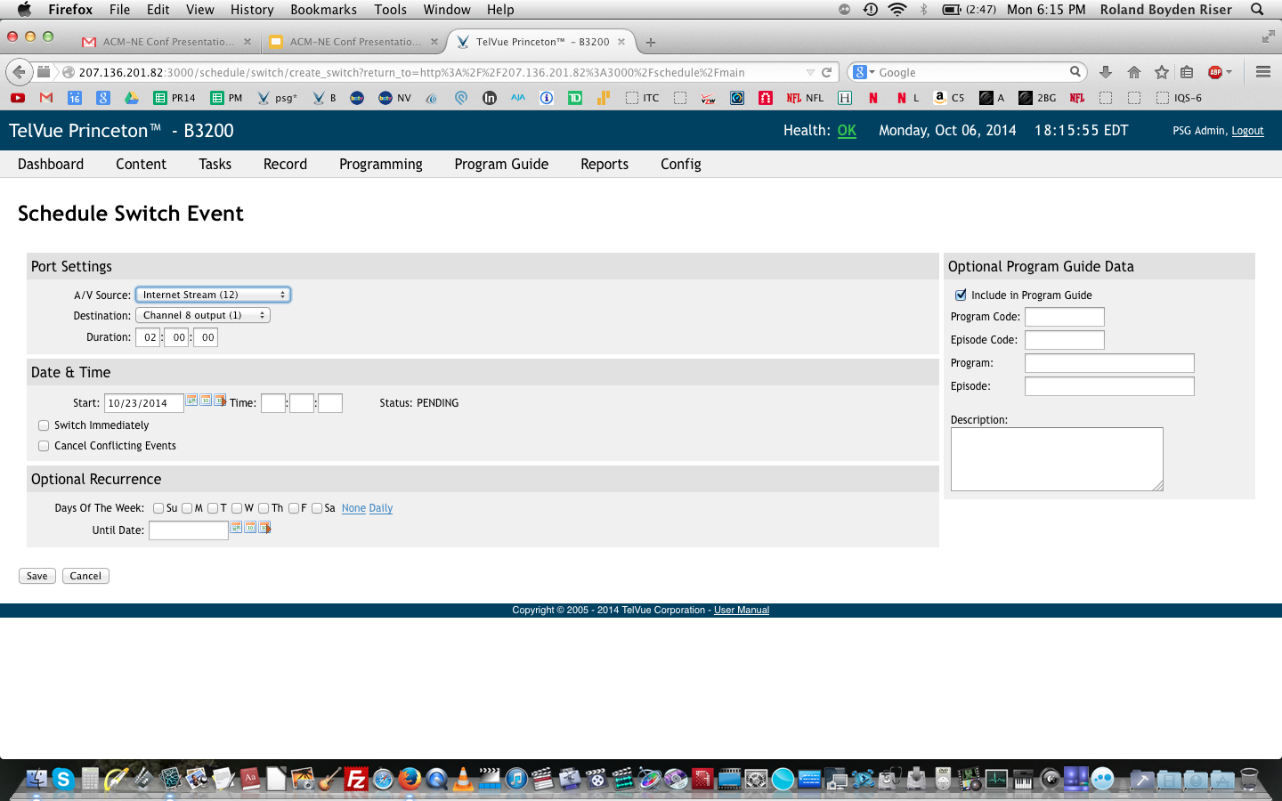
Switch Server to Internet Stream
Input: Internet Stream
Ouput: Channel 8

Slide 16
Disadvantages of IP streaming
YouTube post-recording processing glitch
Copyrighted music will get flagged
Dependent on adequate upload speeds - limited locations

Slide 17
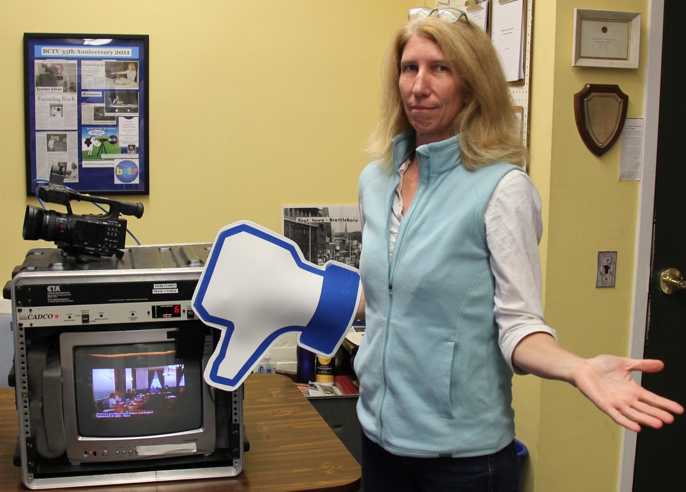
Compare to: cable drops - what’s not to like?

Slide 18
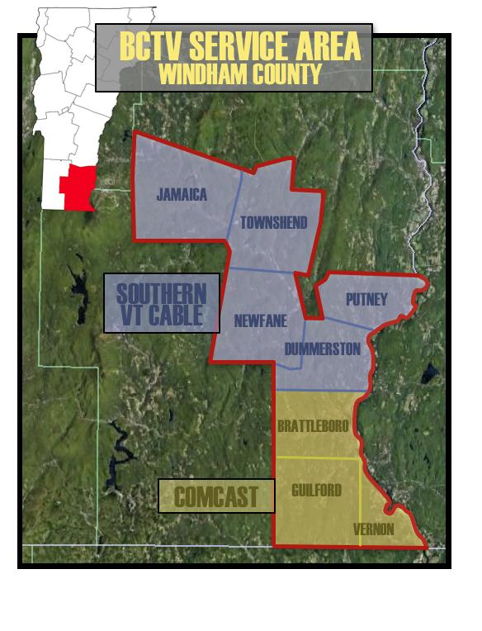
Cable Drops
Limited locations
Not spread out through service territory

Slide 19
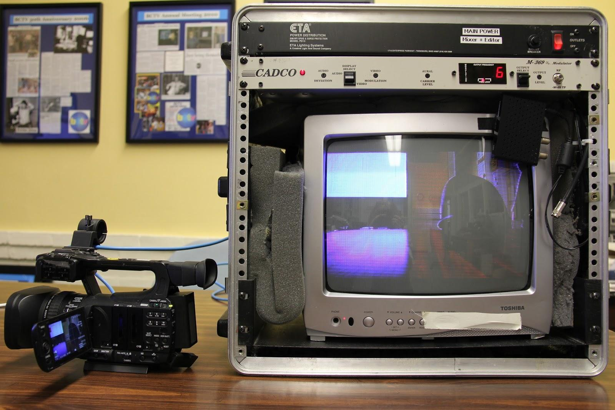
Picture quality downgrade

Slide 20
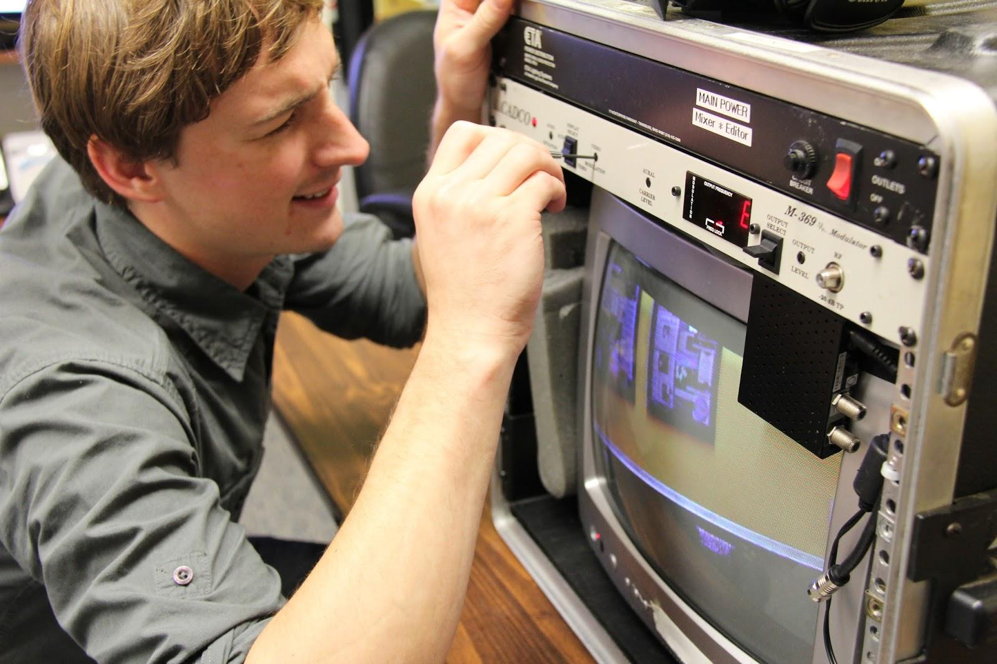
Difficult to adjust

Slide 21
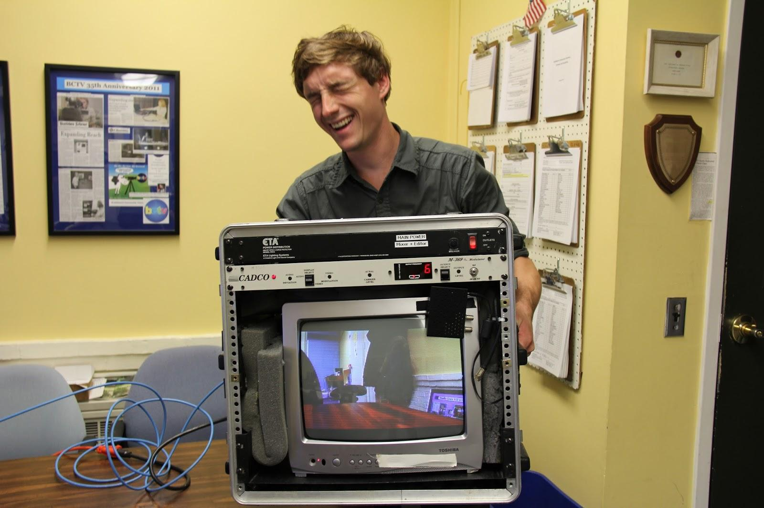
Pain to haul around

Slide 22
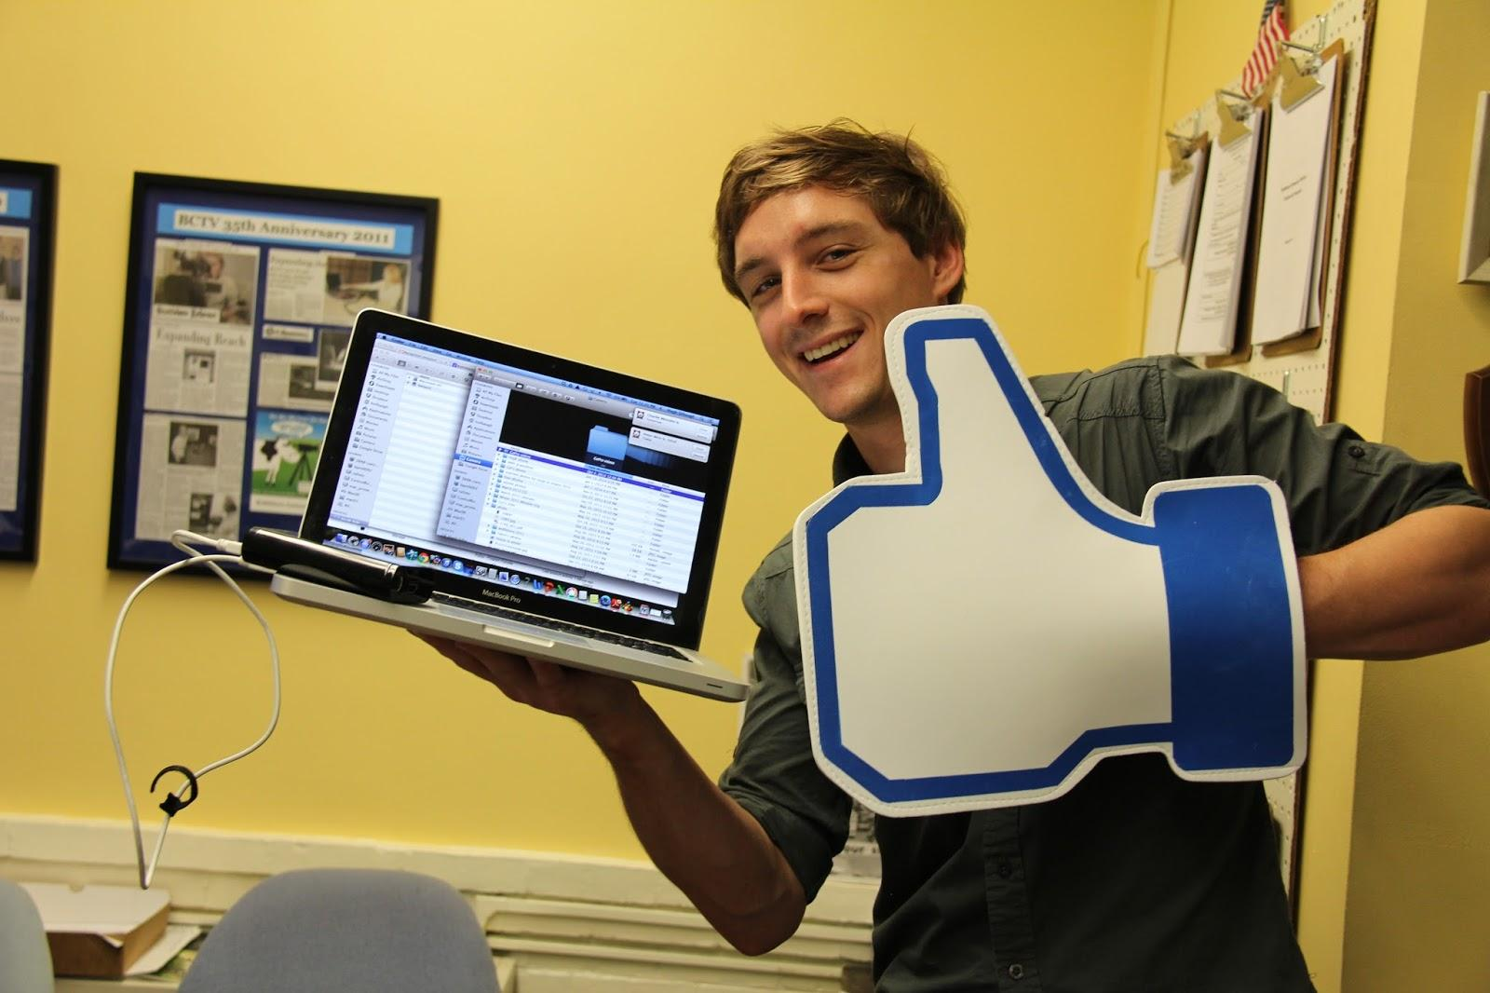
Compare to web technology - not limited to staff productions

Slide 23
Enhances presentations
Many productions incorporate web-reliant elements: Skype, Google Hangouts
Image quality reliant on internet speed
PowerPoint presentations common but not “made for TV”
Use Google Apps Toolbox to enhance
[screencast]

Slide 24
And the point is…
Cable access is “evolving” with the ability of high-speed internet to deliver:
  More efficient workflows
  Live programming unrestricted by cable drops and equipment
  Broadcast quality web-based programming
  Everything is moving in this direction

Slide 25
Contact us:
Cor Trowbridge, Executive Director
cor@brattleborotv.org
Roland Boyden, Production Manager
roland@brattleborotv.org

